Slide 1

Ideonella sakaiensis, the Earth’s saving bacteria
BIO–372 : Microbiology
Jean Barenghi, Antonin Berger, Thibaut Hennel & Coline Maille

Slide 2
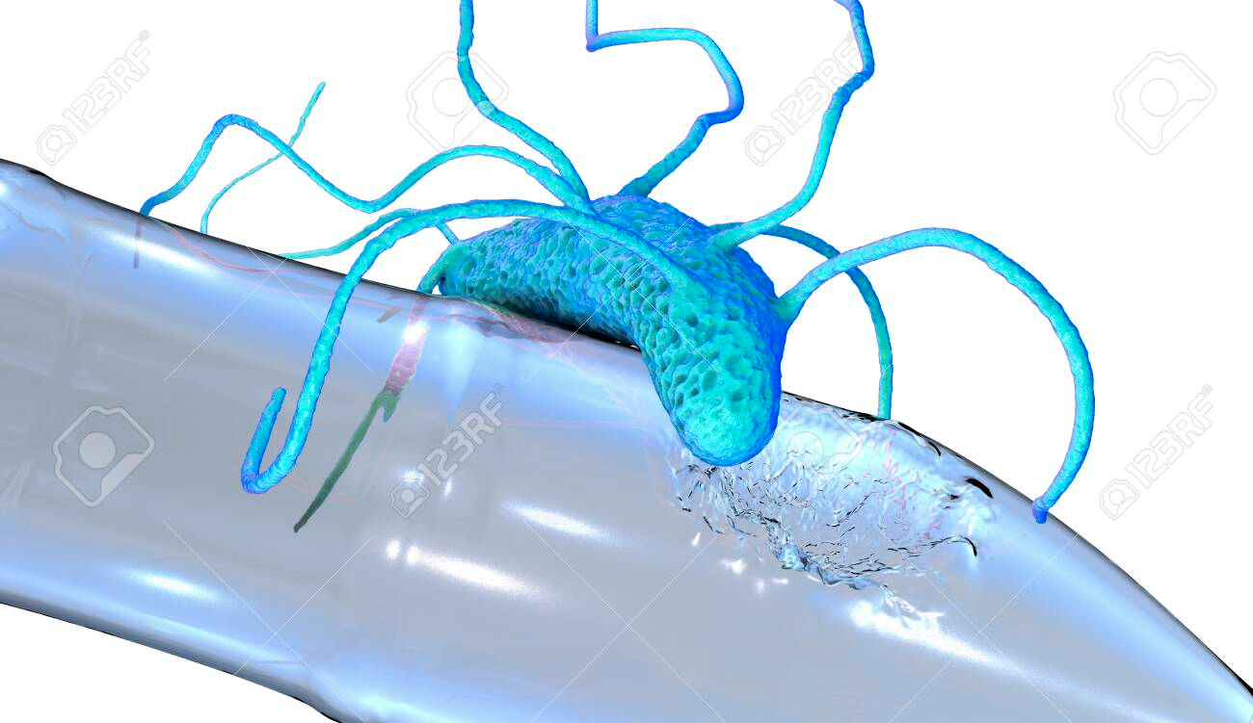
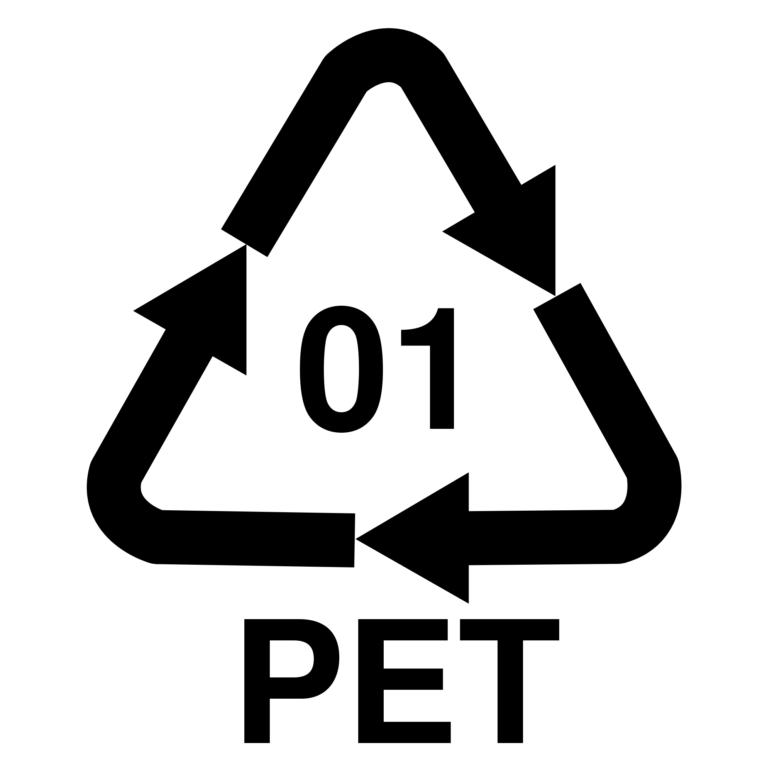
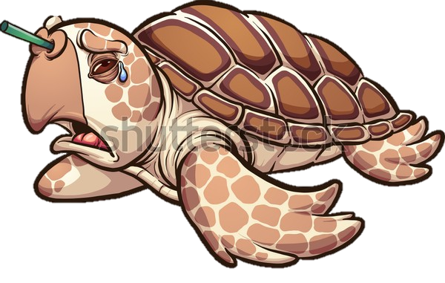
Introduction
Plastic pollution : a global threat.
Ideonella Sakaiensis, the plastic eating bacteria
Mechanisms of plastic degradation
Image source: https://www.123rf.com/photo_127986519_stock-illustration-plastic-degrading-bacteria-ideonella-sakaiensis-3d-illustration-recently-discovered-bacteria-that-ha.html
Image source: shutterstock.com/fr/image-vector/sad-sea-turtle-crying-plastic-straw-1156039546
Image source: https://www.chemicalsafetyfacts.org/types-plastic-food-packaging-safety-close-look/

Slide 3
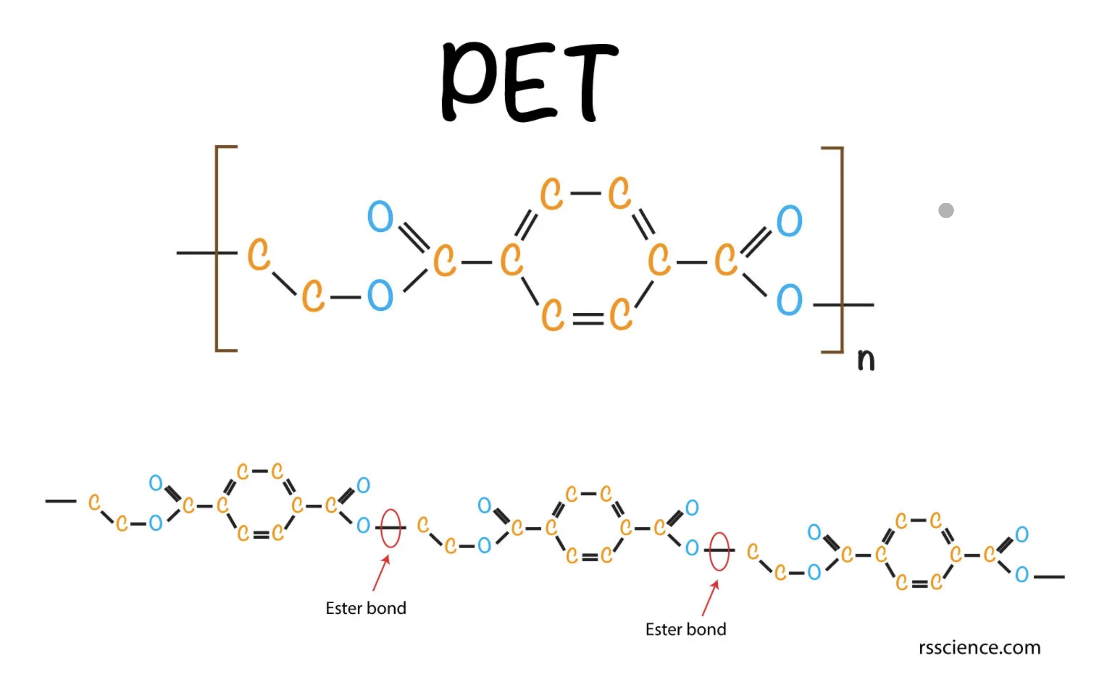
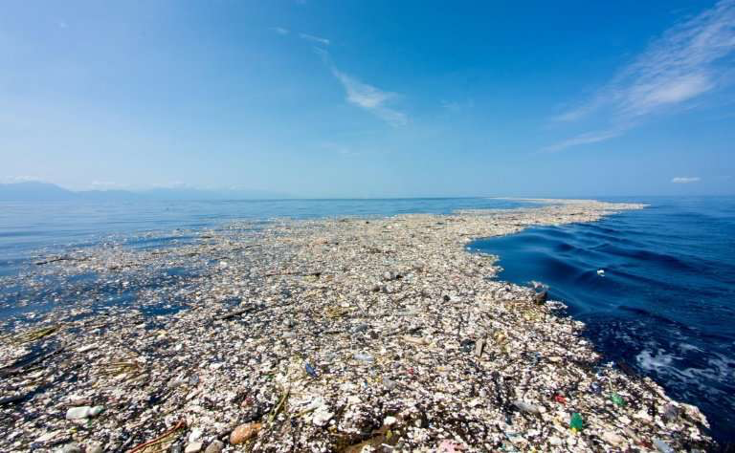
What is PET ?
Synthetic polymer made from non- renewable petrochemicals like fossil oil.
Found in products such as plastic bottles.
300 million tons produced per year.
More than 1 million sea creatures die from it every year.
Image source: https://rsscience.com/plastic-eating-bacteria/
Polyethylene Terephthalate
Highly water resistant.
Xenobiotic chemical bonds.
Possesses multiples characteristics which renders its biodegradation very difficult:
- High MW
- Long-chain polymer structure.
The Great Garbage patch in the Pacific Ocean
Image source: https://www.forbes.com/sites/scottsnowden/2019/05/30/300-mile-swim-through-the-great-pacific-garbage-patch-will-collect-data-on-plastic-pollution/

Slide 4
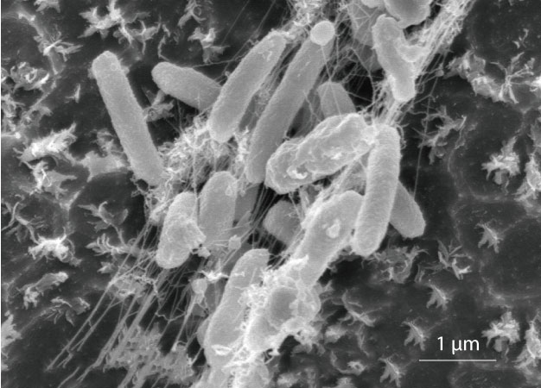
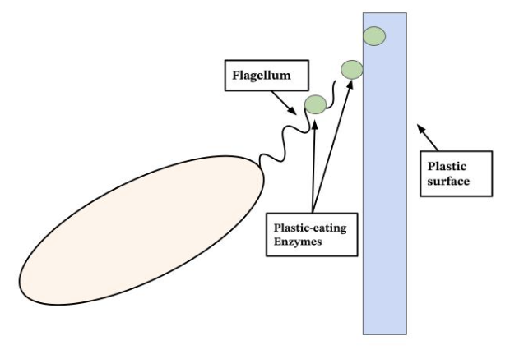
Ideonella Sakaiensis
What is it?
Bacterium capable of breaking down and consuming PET, using it as carbon and energy source.
Characteristics
Gram negative (with thin cell wall and high lipid content): resistant abilities and genes; could include antibiotic resistance.
Flagellum: mobility; adherence on PET; may also function to secrete PET-degrading enzymes onto the PET surface known as PETase.
Aerobic aspect: can only grow in an oxygen-containing environment (ex: oxygen-rich soil, moist and aerated).
Source: Keio University by Nature Research Custom Media
Source: Wikipedia

Slide 5
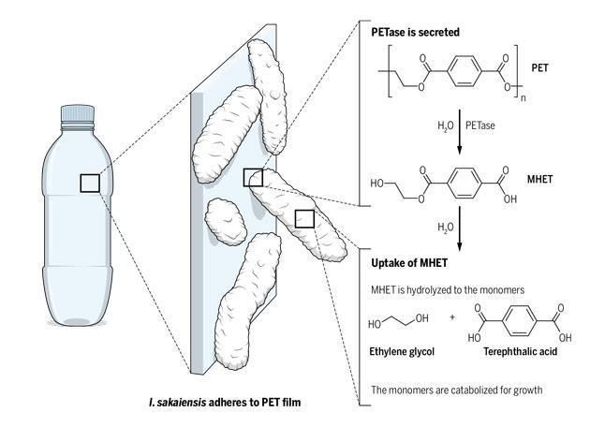
Mechanisms of PET degradation
IsPETase :
High activity
Low stability
IsMHETase :
High specificity
Four elementary steps of degradation :
Nucleophilic attack
Bond cleavage
Nucleophilic attack
Deacylation
MHETase
Image source: https://www.science.org/doi/10.1126/science.aaf2853

Slide 6

Conclusion
Ideonella Sakaiensis is a promising tool to fight environmental pollution.
Example of use : Coagulation Filtration System, to filter microplastics from water and make it drinkable.
Limitations : low plastic degradation rate (0.13mg/24h).
Image source : https://fr.depositphotos.com/334077450/stock-illustration-bacteria-eating-plastic-ideonella-sakaiensis.html

